Slide 1
Presenter:
Superintendent David S. Doty
College and Career Ready

Slide 2
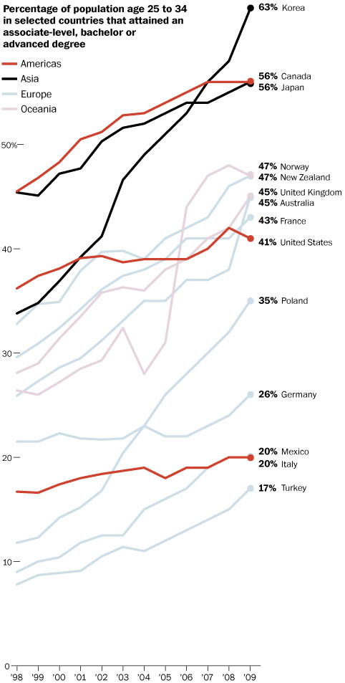
U.S. falls in global ranking of young adults who finish college
By Daniel de Vise, Published: September 13
America’s global rank in college completion among young adults is slipping, according to a report released Tuesday, signaling that the higher education ambitions of other nations are progressing at a swifter pace.
The analysis comes two years after President Obama sought to stir the nation’s competitive spirit with a pledge to retake the lead by 2020.
Instead of gaining ground, the United States has fallen from
12th to 16th in the share of adults age 25 to 34 holding degrees, according to the report from the Organization for Economic Cooperation and Development. It trails global leaders South Korea, Canada and Japan and is mired in the middle of the pack among developed nations.
The stagnant U.S. performance on this key international benchmark reflects at least two trends: the rapid expansion of college attendance in Asia and Europe, and the continuing emphasis on four-year degrees in the United States while other nations focus far more on one- and two-year professional credentials.
“Most of these countries are moving ahead,” said Jamie Merisotis, chief executive of the Lumina Foundation, an advocate of higher education reform. “And we are stuck in neutral.”
Obama’s pledge challenged a society generally presumed to have the world’s best higher education system. The United States ranks second, after Norway, in share of adults age 25 to 64 with bachelor’s degrees. Top U.S. universities perennially draw huge numbers of foreign students.

Slide 3
Canyons School District ACT Results 2011

Slide 4
“The level of academic achievement that students attain by eighth grade has a larger impact on their college and career readiness by the time they graduate from high school than anything that happens academically in high school.”
“Making sure that all eighth-grade students have attained the knowledge and skills that put them on target to becoming ready for college and career is the single most important step that can be taken to improve their college and career readiness.”
-
The Forgotten Middle, ACT, 2008

Slide 5
Canyons Standard Diploma:
The traditional diploma will remain aligned with
the Utah State Office of Education's and Canyons
School District's graduation requirements.
Advanced Diploma:
The Advanced Diploma will require 27 credits, including the
State Office of Education's required core credits and electives and two
credits of world language. This college- and career-ready diploma also requires credits to be earned in more rigorous laboratory sciences, college-prep English in the 12th grade (college-prep, Advanced Placement, Concurrent Enrollment, etc.), and competency in Algebra 2.
Honors Diploma:
To earn the Honors Diploma, students must complete the Advanced Diploma's requirements and earn College Readiness Benchmark Scores on the ACT college-entrance exam.
Canyons Differentiated Diplomas

Slide 6
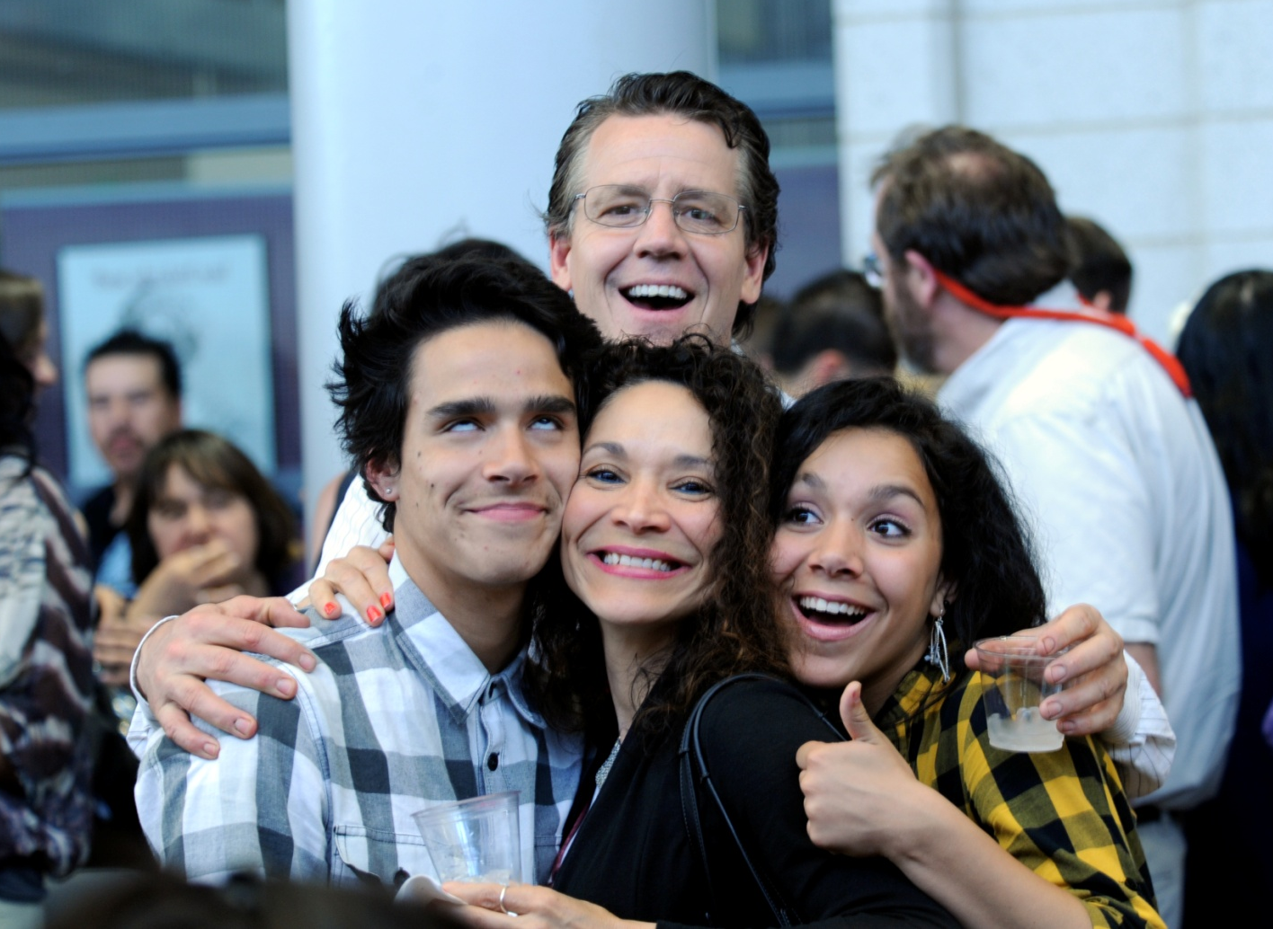
Graduating Seniors Receive College- and Career Diplomas Posted: 02 Jun 2011 08:23 AM PDT The Class of 2011 is making history. This year’s graduating seniors are the first in Canyons School District – and in the State of Utah – to receive a college- and career-ready diploma. And, in this inaugural year, 60 percent of Canyons graduating seniors have earned one. On June 7, 2011, more than 1,350 Canyons high school seniors will receive an Advanced or Honors Diploma. Approved by the Canyons Board of Education in February 2010, the Advanced and Honors diplomas indicate students possess the skills needed to be successful in college or today's workforce. College- and career-readiness is strongly linked to the classes students take. The more rigorous the coursework, the better prepared the student. The Advanced and Honors diplomas require students to complete two years of foreign language, and take more rigorous coursework in science, math and English. Students earning the more challenging Honors Diploma also have achieved Career and College Readiness Benchmark Scores on the ACT college entrance test. The Canyons Board of Education was pleased to recognize students earning Advanced and Honors diplomas at a May 31 evening reception. The Board and Superintendency congratulate these students for their achievement, and commend them for setting the bar high for generations to come. News coverage: The Salt Lake Tribune http://www.sltrib.com/sltrib/news/51918546-78/students-advanced-college-diplomas.html.csp

Slide 7
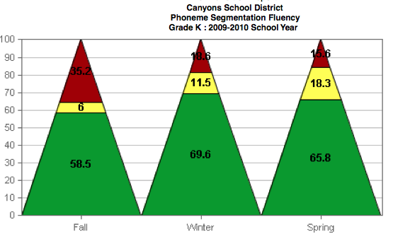
2009-2010 Kindergarten Results

Slide 8
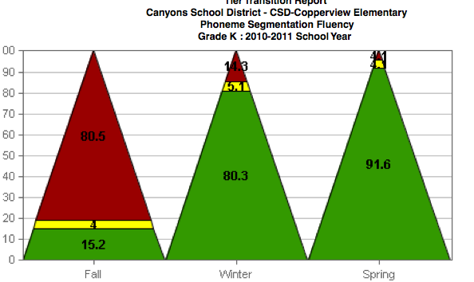
Copperview Elementary

Slide 9
College and Career Ready

