Slide 1
The Value Imperative: Meeting the Total Needs of The People of Utah
Greg Poulsen
Senior Vice President and
Chief Strategy Officer

Slide 2
Current Debt and Unfunded Federal Obligations by Category ($ Trillions)
Total National Debt
Social
Security
Medicare
Source: Office of Management and Budget, May, 2011

Slide 3
The Effect of Medicaid Expansion on Utah
Source: Initial Analysis of Federal Health Reform Legislation. Utah Department of Health. March 30, 2010. Available online at
http://www.ncsl.org/portals/1/documents/health/UDOH10-2010.pdf.
Source: Fiscal Year 2011 Budget Summary. Governor’s Office of Planning and Budget. May 2010. Available online at http://www.governor.state.ut.us/budget/Budget/Budget%20Summaries/FY%202012_SumBk.pdf
Notes:
The Medicaid share of the Utah General Fund has nearly doubled in the last ten years.
New enrollment in Medicaid associated with the Affordable Care Act will add at least 110,000 new individuals to the rolls, an increase of 52% over current enrollment.
Projections suggest new enrollment will cost the state $834.1 million over the next ten years.

Slide 4
Commercial Health Insurance Premiums
Notes:
For Intermountain Healthcare, the total premium has increased 108% over the same period.

Slide 6
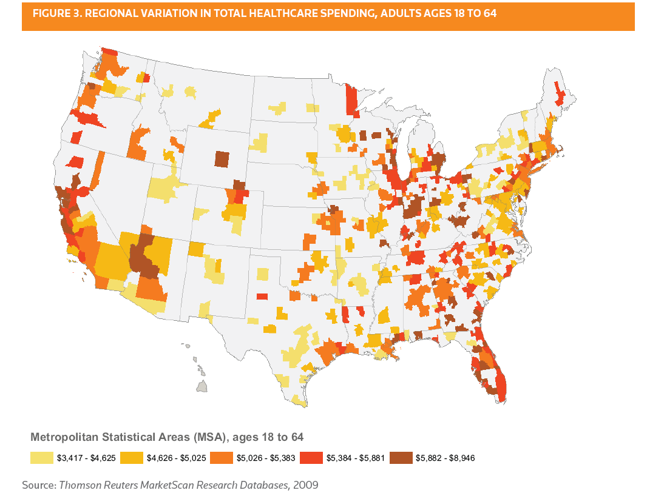
Thompson Reuters: Geographic Variation in Spending Among the Commercially Insured, July 2011
“Ogden, Utah has the lowest medical care spending of $2,623; the highest spending MSA, Anderson, Indiana was nearly three times higher, at $7,231”
1, 8, 12

Slide 7
Healthcare Cost and Benefit are not Linearly Related
Health Benefit*
Cost
*”Adding years to life and life to years”
From Alain Enthoven and Avedis Donabedian

Slide 8
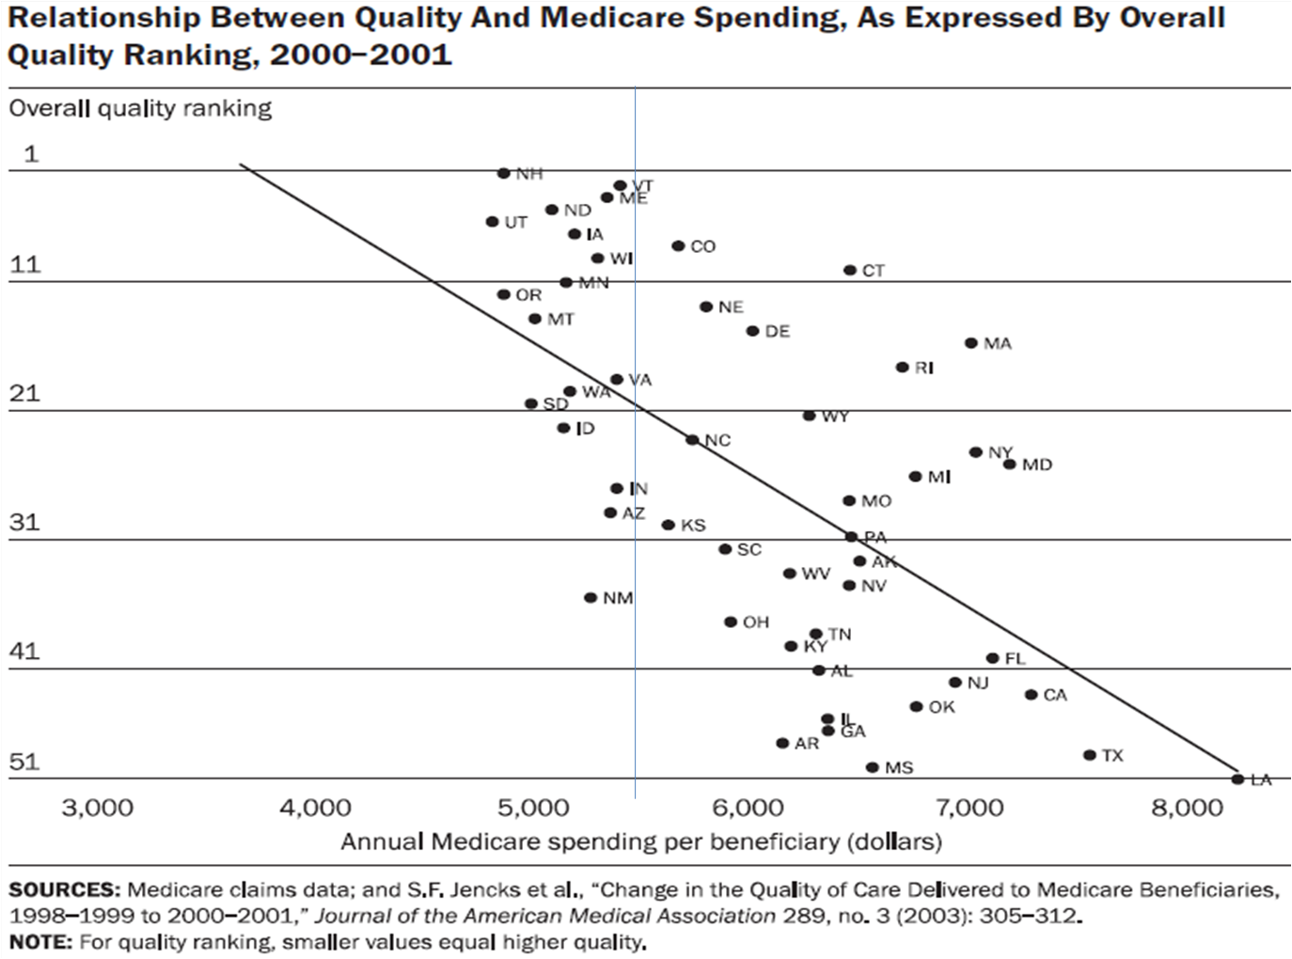
When More is Less

Slide 9
Diabetes: A Medical Example Of “Quality Waste” (New York State)
Potentially Avoidable Complications:
$813 million
Diabetes
Relevant Services
$1.32 billion
Appropriate services:
$515 million
Notes:
9
9

Slide 10
With Fee-For-Service, We Get What We Pay For
“Every system is perfectly designed to achieve the results it gets.”
W. Edwards Deming
“Fragmented care is designed to maximize inefficiency, and therefore, to maximize revenue.”
James Orlikoff

Slide 11
Does Utah / Intermountain have room to improve?
 | Utah Rank | Utah Rate | National Average | Difference
Healthcare Cost Per Capita | 1 | 3972 | 7026 | -43%
Percent Asthmatics with ER Visit | 1 | 10.8 | 16.3 | -34%
Medicare Admits per 100,000 Beneficiaries | 1 | 3725 | 6291 | -41%
Hospital Intensity Index (last 2 years) | 1 | 0.504 | 1 | -50%
Medicare 30 Day Hospital Readmission | 2 | 13.6 | 17.5 | -22%
Home Health Patients with Hosp. Admit | 1 | 21.2 | 28.7 | -26%
Percent Short-Stay Nursing Home with Hospital Admit | 1 | 13.2 | 20.8 | -37%
Infant Mortality% | 1 | 0.45 | 0.68 | -34%
Mortality Amenable to Healthcare p 100,000 | 2 | 64.1 | 89.9 | -29%
Source: The Commonwealth Fund. Aiming Higher; State Scorecard on Health System Performance, 2009

Slide 12
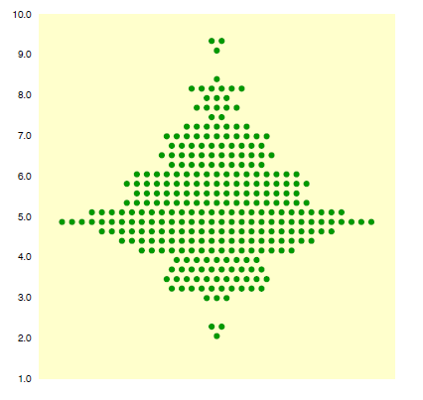
Coronary Artery Bypass Grafts per 1,000 Medicare Enrollees

Slide 13
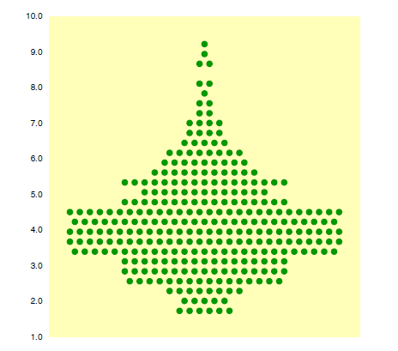
Spine Surgery per 1,000 Medicare Enrollees
Source: Dartmouth Atlas of Healthcare

Slide 14
Local Variation for Common Outpatient Procedures (Highest vs. Lowest County Along Wasatch Front)
Source: Utah Health Data Committee,
Based on County of Residence, Age Adjusted

Slide 15
Key Components of Shared Accountability
Realign financial incentives for providers of healthcare – move from fee-for-service to pay for value
Align incentives and information for members and patients
Involve patients and members financially in health decisions
Provide information to help them work with their physician in making wise choices
Continue to refine patient care (Utah is the national leader)

Slide 16
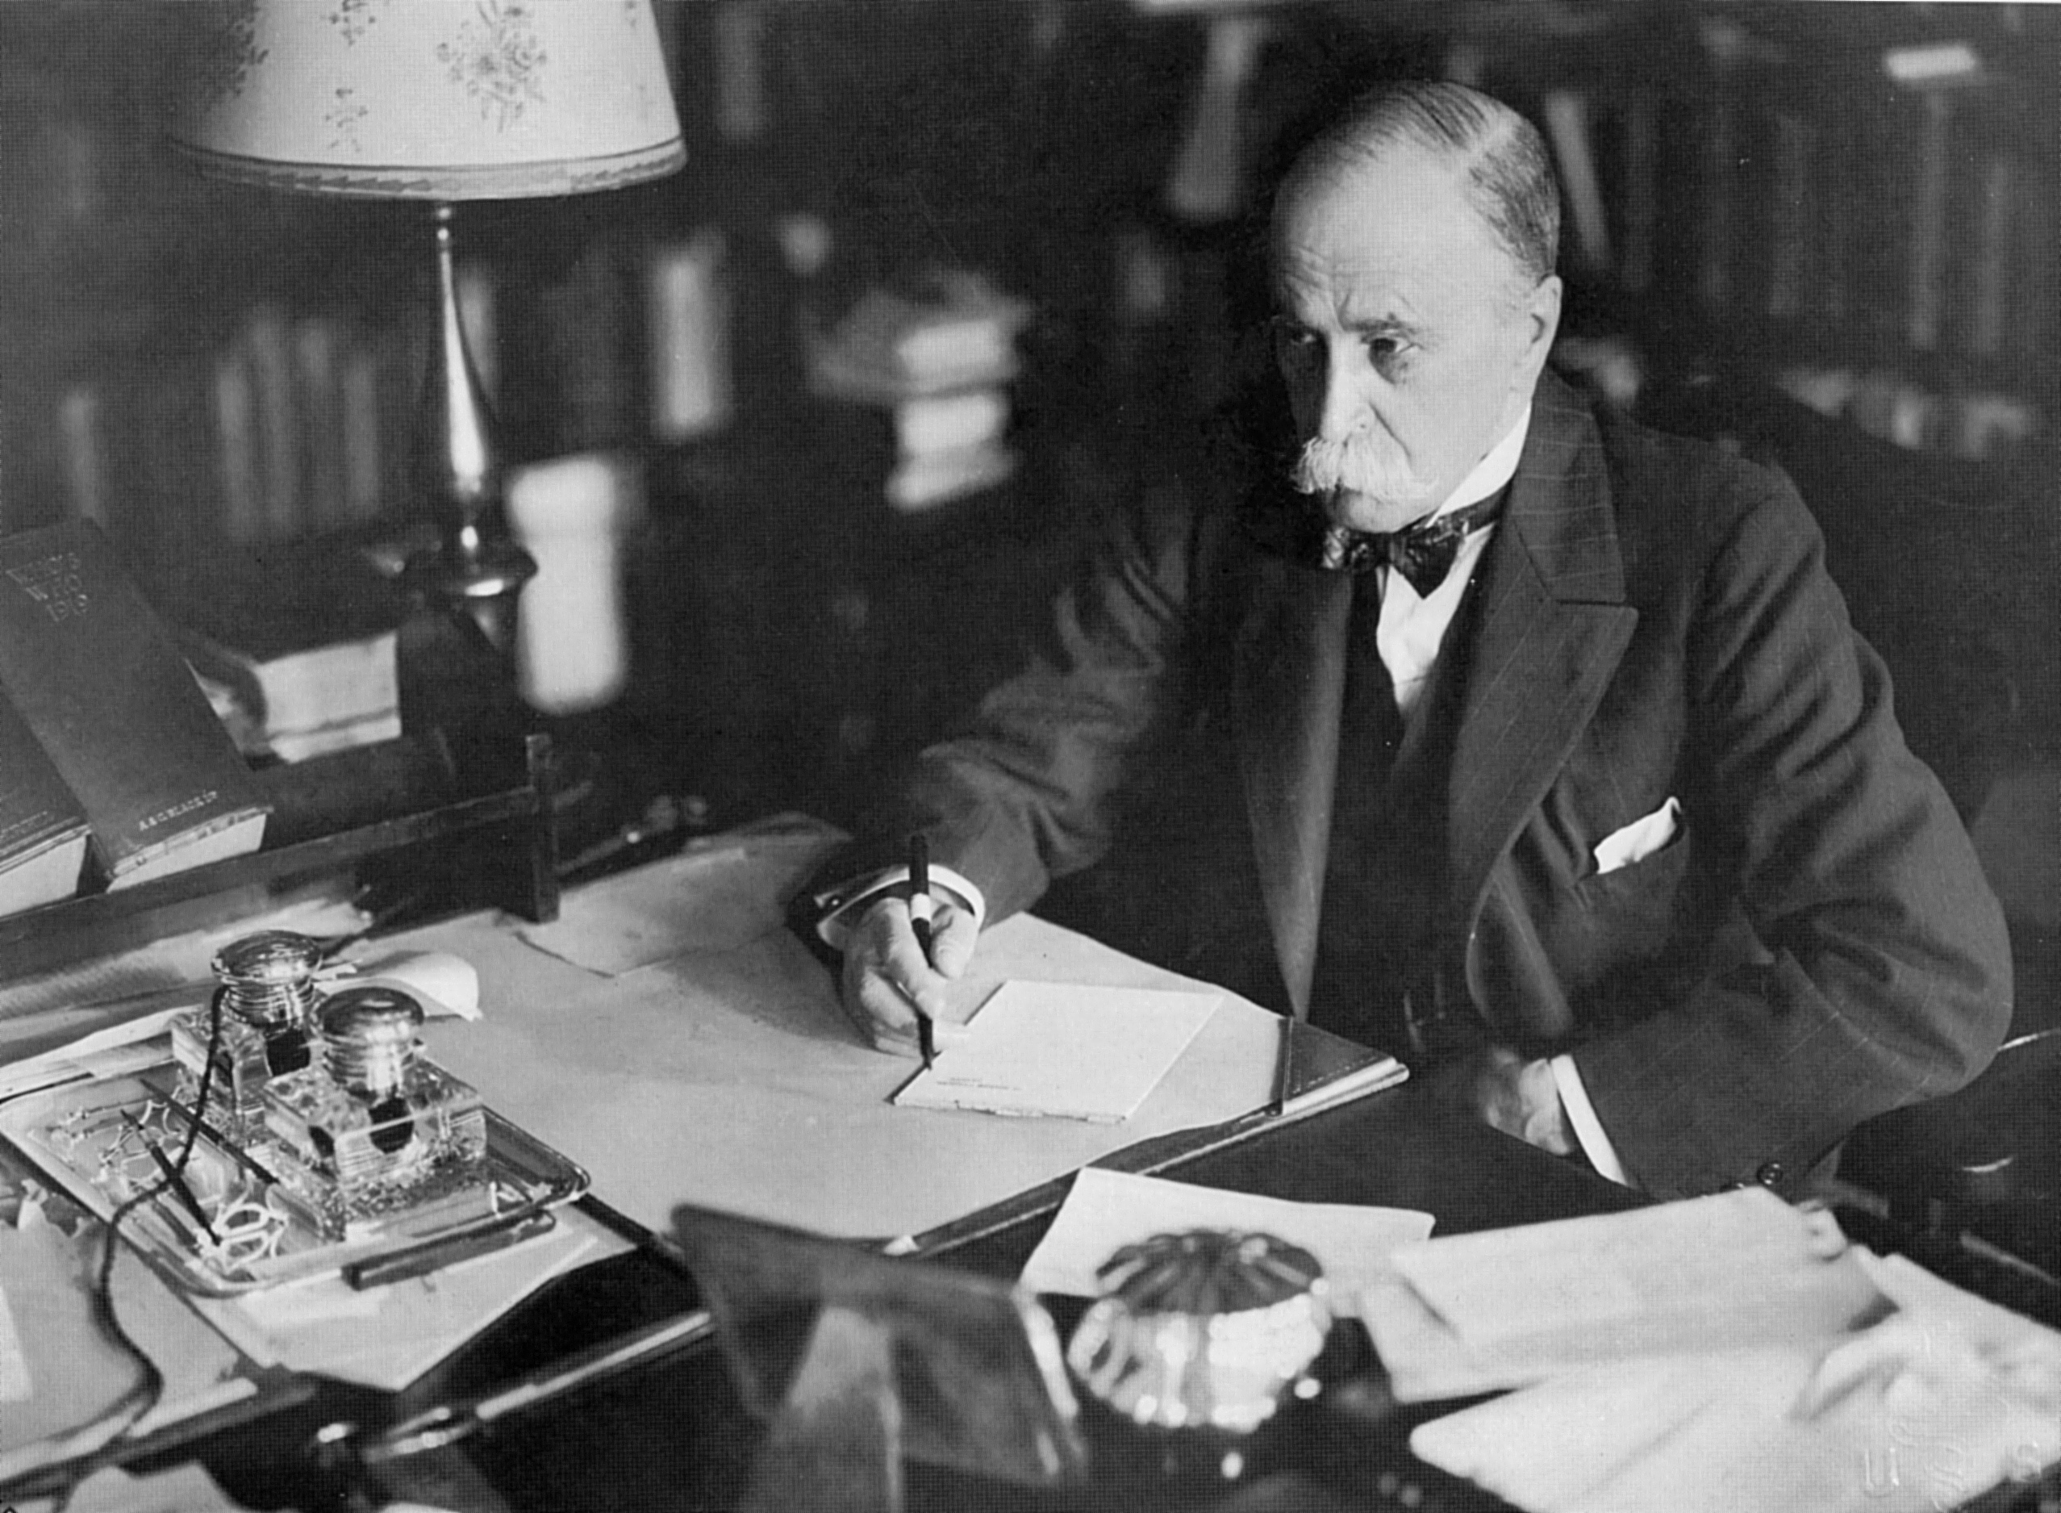
“Medical care must be provided with utmost efficiency. To do less is a disservice to those we treat, and an injustice to those we might have treated.”
Sir William Osler, 1893

