Slide 1
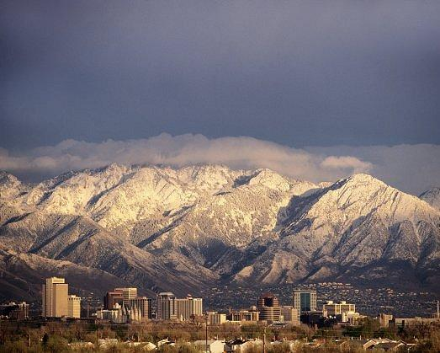
The Wasatch Choice for 2040
Alan Matheson
Envision Utah

Slide 2
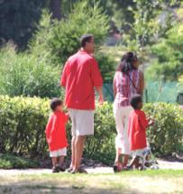
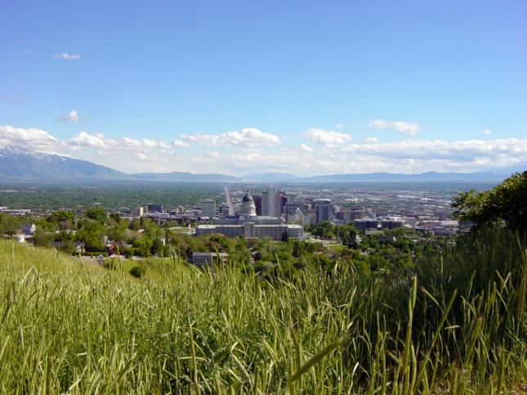
We enjoy high quality of life…

Slide 3
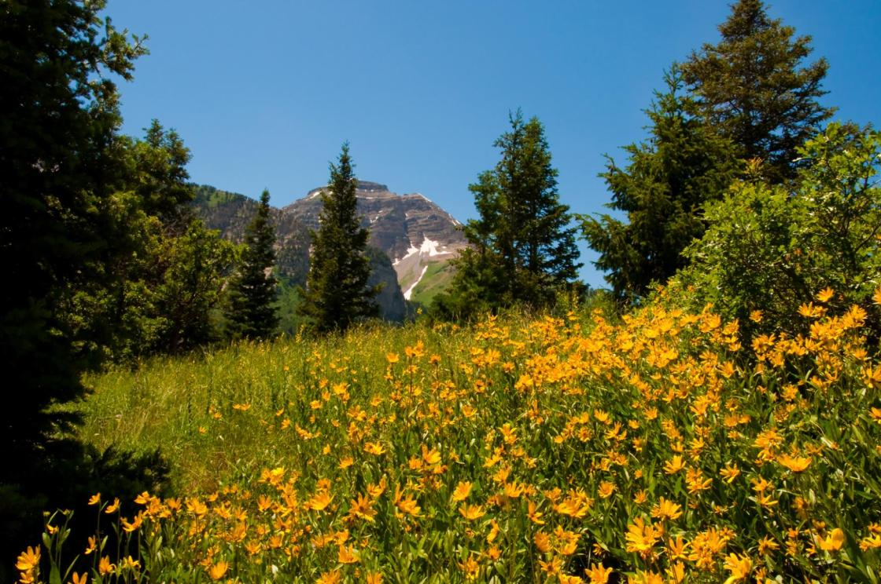
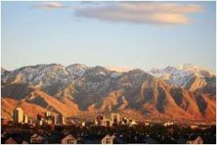
We enjoy access to the outdoors,

Slide 4
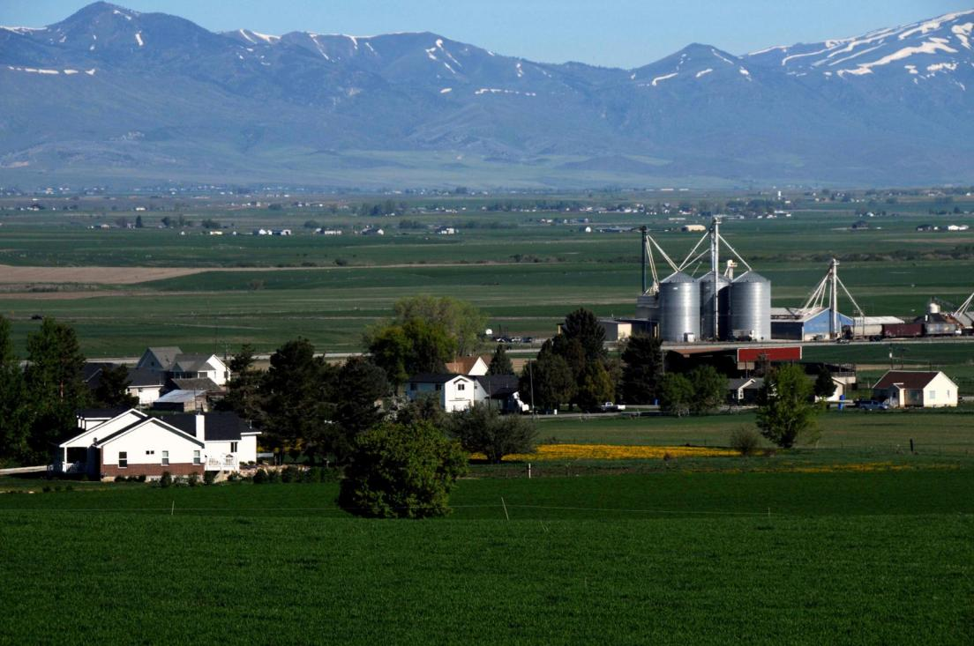
friendly communities,

Slide 5
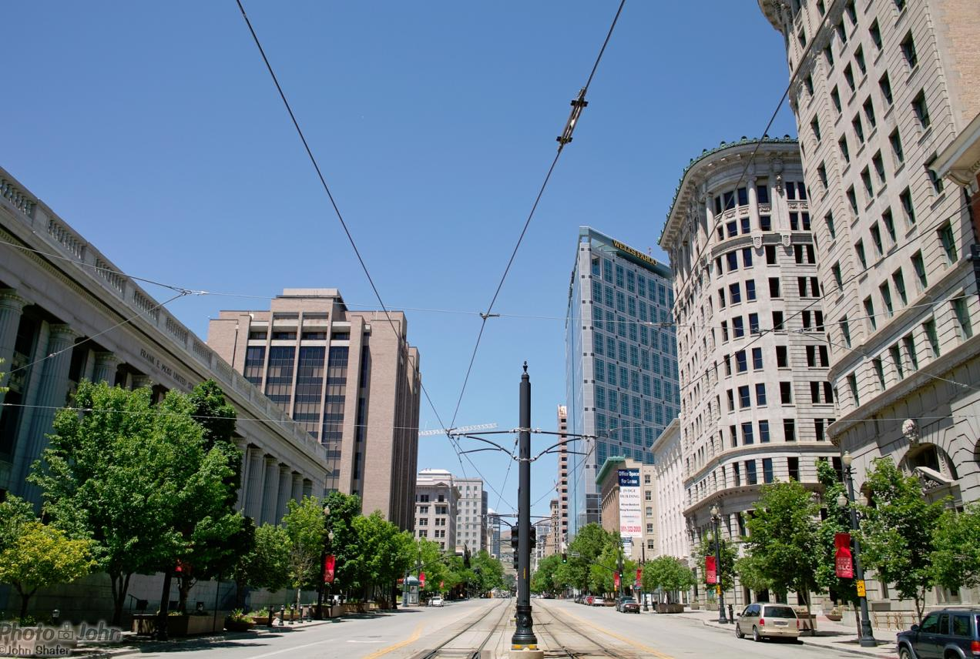
and rich economic opportunities…

Slide 6
But growth is coming…
In Salt Lake, Davis, Weber, and Utah counties, population will increase by 65%, adding another 1.4 million residents by 2040
Notes:
The way we grow will have significant effect on our quality of life in the future.

Slide 7
Miles driven daily will almost double by 2040
90+ Million
49 Million
WFRC and MAG
Notes:
Business as usual: driving increases.
Imagine the impact that will have.

Slide 8
Air Pollution…
As our population continues to grow and we drive more and more, our air will become more polluted, threatening our health and economic prosperity.

Slide 9
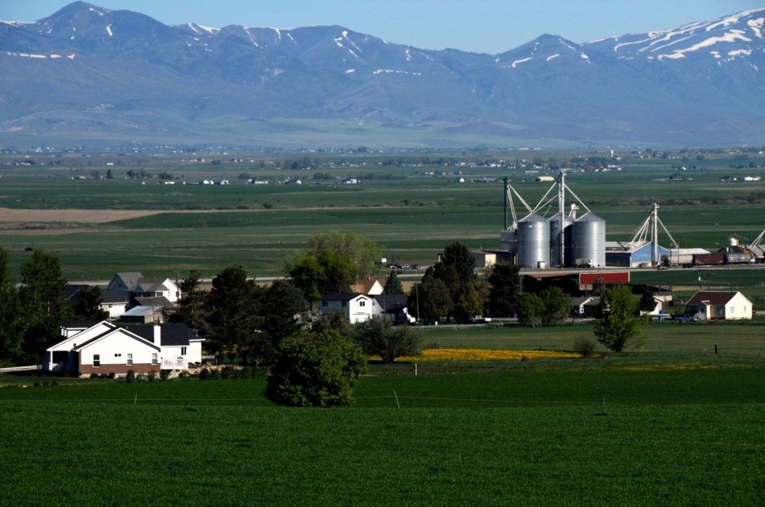
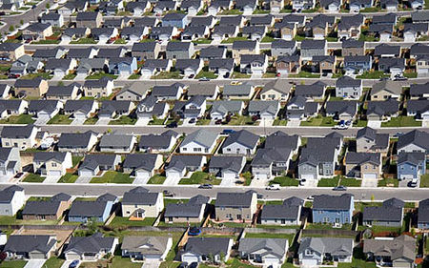
Loss of open space and access to the outdoors…
In Salt Lake, Davis, Weber and Utah Counties, we’ll add nearly 300 square miles of developed land by 2040.

Slide 10
The face of America, and Utah, is changing. (Courtesy Dr. Nelson, University of Utah, Department of City and Metropolitan Planning)
# of People Turning 65 Each year [Figures in 000s]
Source: US Census Bureau – 65+ in the United States: 2005; Wan He, Manisha Sengupta, Victoria A. Velkoff, & Kimberly A DeBarros. December 2005.
Notes:
We’re not just growing. We are changing.
Remarkable confluence of demographic trends:
First wave of baby boomers will be 65 in 2011
Largest number of millenials reaches 22 in 2012
Married couples with children make up less than 25% of US households

Slide 11
The “American Dream” is now plural “Dreams” (Courtesy Dr. Nelson, University of Utah, Dep’t of City and Metropolitan Planning)
25% of Americans want walk/bike access to jobs, transit and errands.
50% of Americans want diverse, mixed-use neighborhoods.
75% of Utahns say the “ideal community” includes a mix of housing and lot sizes, mix of ages/life stages, and transit options.
Fewer than 10% have those options now.
Notes:
The “American Dream” is now plural “Dreams” → not just a home on an isolated large lot anymore. 2010s will be a decade of rental demand
The Dream is changing.
Key drivers are:
Demographic changes
Housing market changes
Housing finance changes
Preference changes

Slide 12
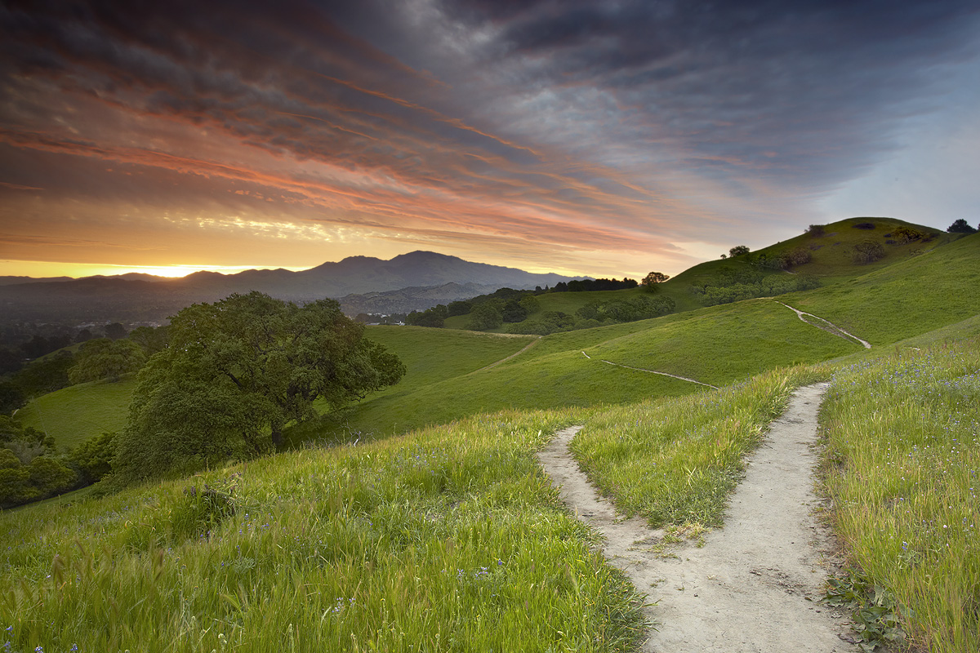
Choice?

Slide 13
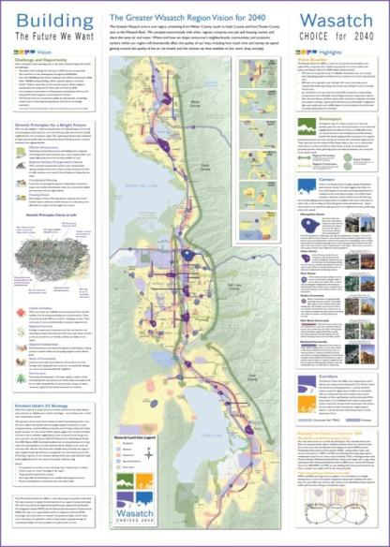
There is a Better Way to Grow…
The Wasatch Choice
for 2040:
Regional Vision for Growth and Development
Notes:
Result of the process is a preferred scenario for regional growth.

Slide 14
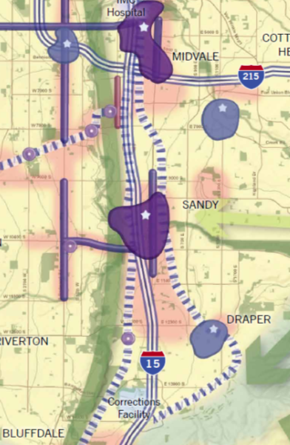
There is a Better Way to Grow…
Focus growth in town centers,
with housing and transportation options.
Notes:
Not government telling people how to live; it responds to the market and to demographic changes.
The Vision puts more new homes and jobs in mixed use, walkable developments, often near transit stations. Live (homes), work (jobs), play (green space, entertainment), shop.
This preserves the character of existing suburban neighborhoods

Slide 15
Wasatch Choice for 2040 – Growth Principles
Provide public infrastructure that is efficient and adequately maintained
Provide regional mobility through a variety of interconnected transportation choices
Integrate local land use with regional transportation systems
Provide housing for people in all life stages and incomes
Ensure public health and safety
Enhance the regional economy
Promote regional collaboration
Strengthen sense of community
Protect and enhance the environment
Notes:
This is not just lines on a map. It reflects principles for how we grow, developed collaboratively by community, government and business, responding to Utah values. Those principles for growth are…

Slide 16
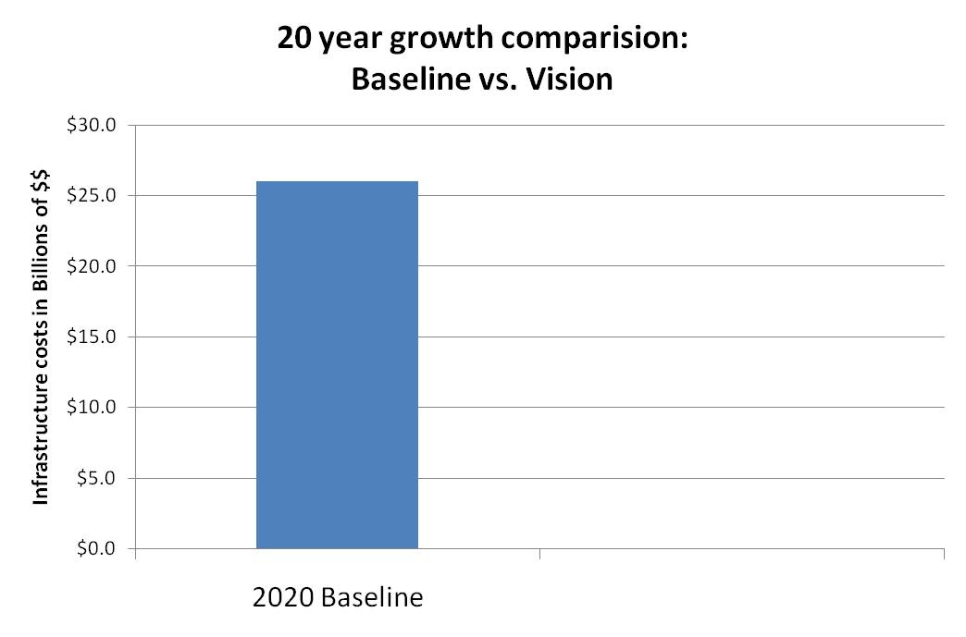
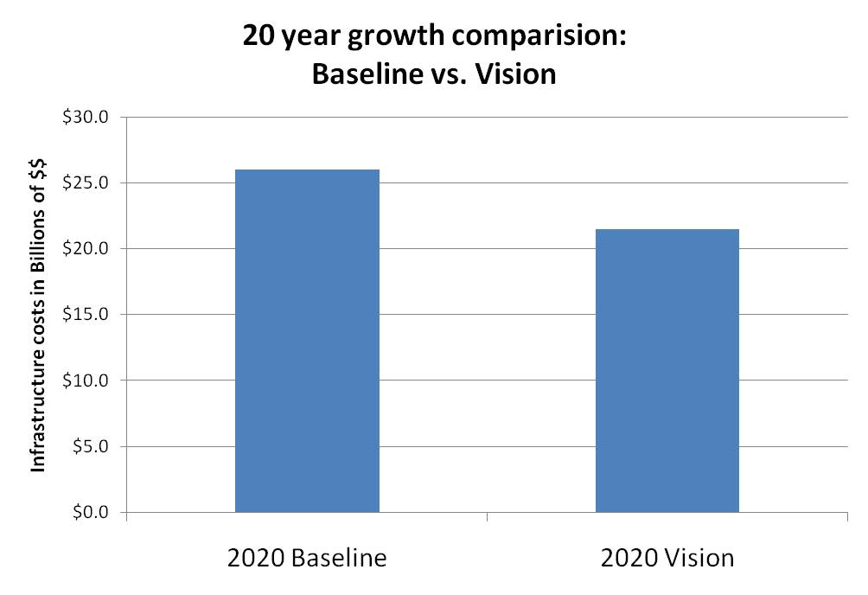
Lower Taxes:
Infrastructure savings in the billions
$26 billion
$21.5 billion
Saves 17% or $4.5 billion over 20 years
Envision Utah Quality Growth Strategy; 1999

Slide 17
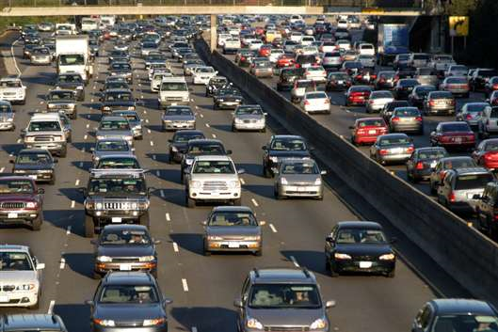
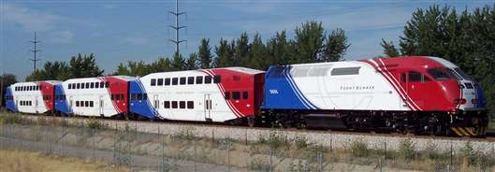
Enhanced Mobility and Economic Growth
The Vision reduces traffic congestion by 18%

Slide 18
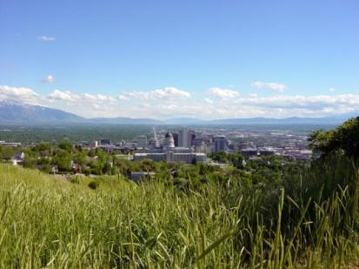
Better Air Quality
Less driving and more transportation choices will lead to cleaner air

Slide 19
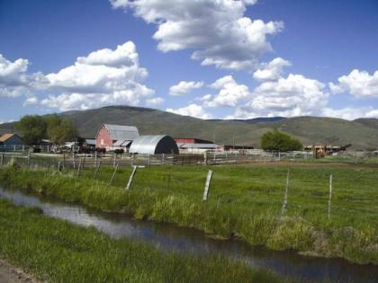
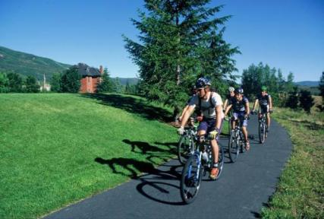
Greater Protection of Critical Lands
By encouraging infill and redevelopment, we will safeguard natural resources, working farms, parks and trails

Slide 20
Implementing the Wasatch Choice for 2040?

Slide 21
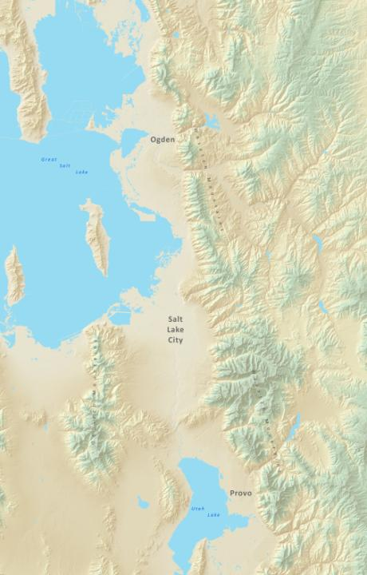
Regional Collaboration
Local Implementation

Slide 22
The Wasatch Choice for 2040 Toolbox:
Transportation Choices
Housing Strategies
Envision Tomorrow +
Innovative Zoning
Financing Strategies
Demonstration Sites
Notes:
Last thing I will talk about…

Slide 23
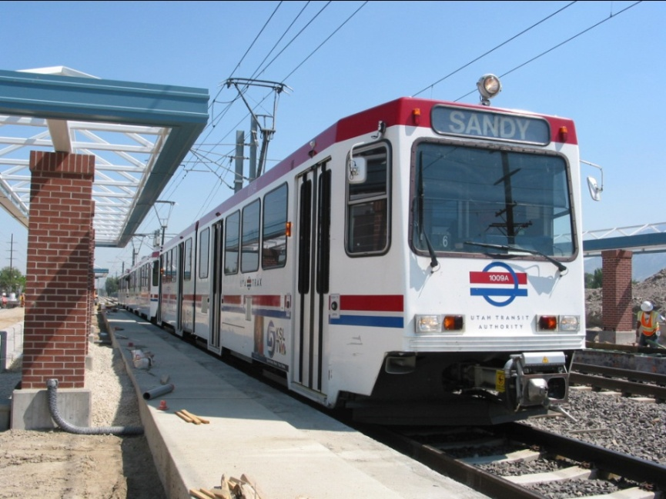
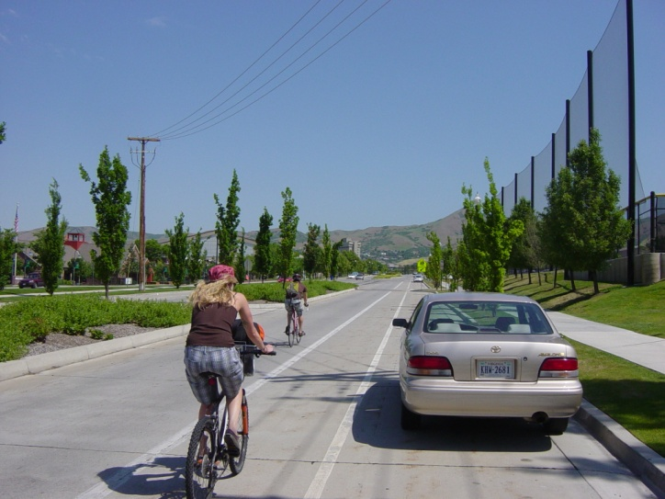
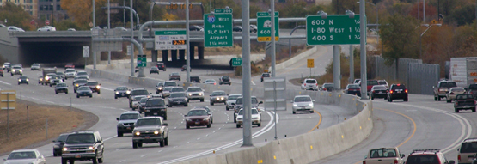
Transportation Choices
Notes:
Key is to provide transportation choices for people. Most people will use their cars; that’s fine. But we need to provide options too, for transit, walking and biking.

Slide 24
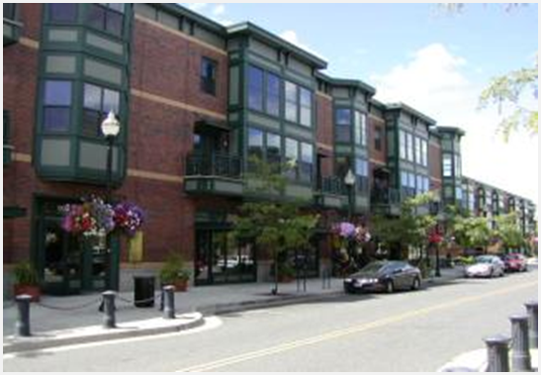
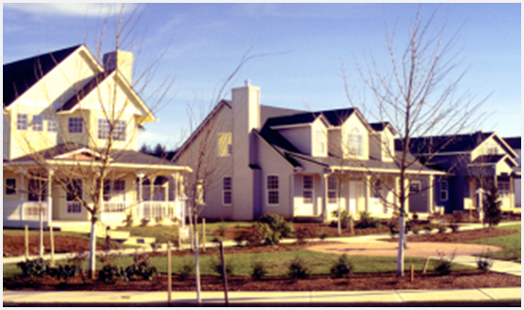
Housing:
- Market driven
- Choices
Notes:
Respond to the market preferences, provide options for different types of housing, different incomes and life stages.
How do we get things built? Cooperation with developers and lending community, through innovative zoning.

Slide 25
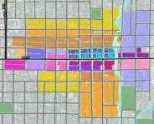
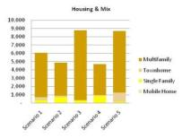
The “Envision Tomorrow +” Model
Tool to help communities make individual decisions
Transportation Effects
Building Energy Consumption
Water Consumption
Air Quality
Return on Investment
Tax Collections
Fiscal Impact
Public Health
Employment Growth
Development Capital
Transportation Safety
Workforce Housing
Public Assets
Scenario Development
Evaluation
Notes:
Limited resources to consider different approaches?
Tool to consider different scenarios and evaluate them.

Slide 26
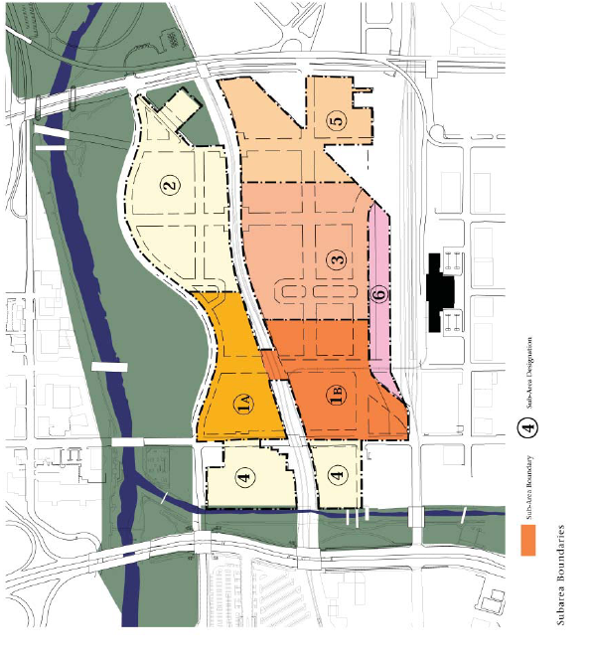
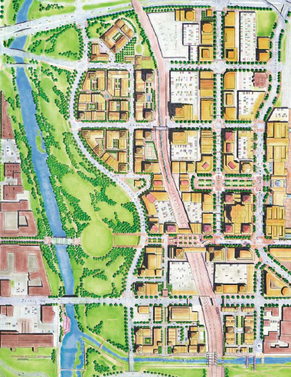
Innovative Zoning
Develop a model code that encourages the use of physical form, rather than separation of land uses, as their organizing principle.
Notes:
Not divide residential (single family detached, rental, townhome), commercial. Allow for a mixed of uses at the appropriate form and scale, and therefore preserve/promote character of development.

Slide 27
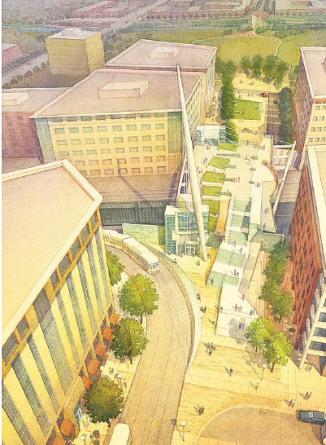
Financing Strategies
Market based
Real return on investment
Innovative strategies
Notes:
Financial community give input
Full partners
Innovative approaches

Slide 28
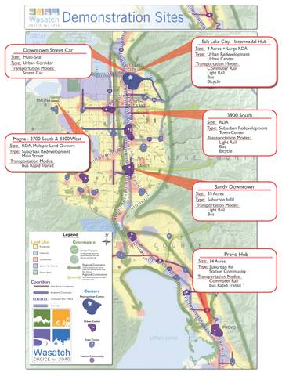
Demonstration Sites
Apply concepts in a ‘real world’ setting
Evaluate different scenarios
Stakeholder and public process
Share lessons learned, approaches

Slide 29
Thank You

