Slide 1
70 Years of Informing Utah’s Future
Utah Foundation’s History and Mission
Narrator: Dan Bammes
Notes:
It was just a few days after I started working with Utah Foundation in January that our president, Steve Kroes, started talking about our 70th anniversary. He showed me several file folders with historical material that had hardly been looked at in most of those years. But we asked a group of graduate students led by Matt Mendez to take a closer look, and we started finding some other original sources as well. What we discovered is that today’s Utah Foundation is very much like what its founders originally had in mind – a non-partisan, independent research group examining critical issues of public policy.

Slide 2
Salt Lake City, 1945
“We wish to point out that it is possible that the
war may end with Japan and economic conditions
so change that a special session of your legislature
will be required and action may be called for on
many matters, which will precipitate this entire
problem. This situation in our opinion is not remote.
It therefore behooves industry to take action at once
and to look forward to this possible contingency.”
Memo to Fred S. Mulock
August 2, 1945
Notes:
Utah suffered during the Great Depression – and prospered during World War Two. By 1945, state tax revenue was more than five times what it had been in 1916. Leaders of the business community worried that a peacetime economy couldn’t sustain the kind of tax revenues the state of Utah had been getting through the war years.
A memo from a consultant – and signed by members of an ad-hoc group of prominent business leaders– said the need for that independent study group was urgent. After all, who knew when the war would end? V-E Day had come months before. None of them knew, of course, that the bombing of Hiroshima and Nagasaki would bring the war to a definitive conclusion just days after they wrote this.

Slide 3
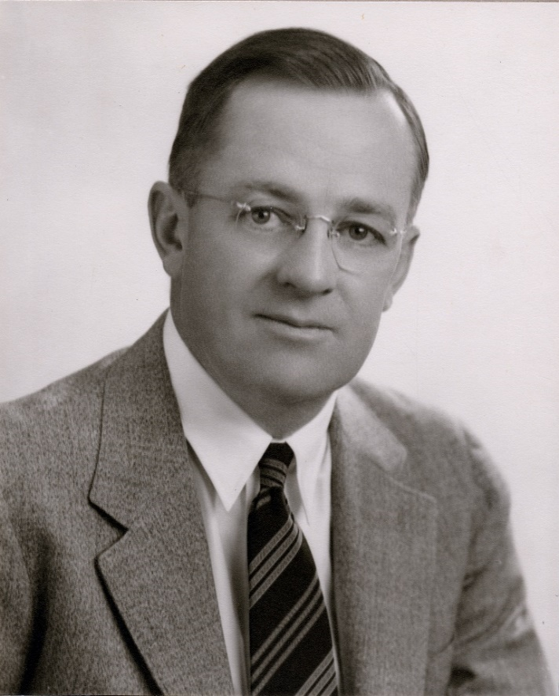
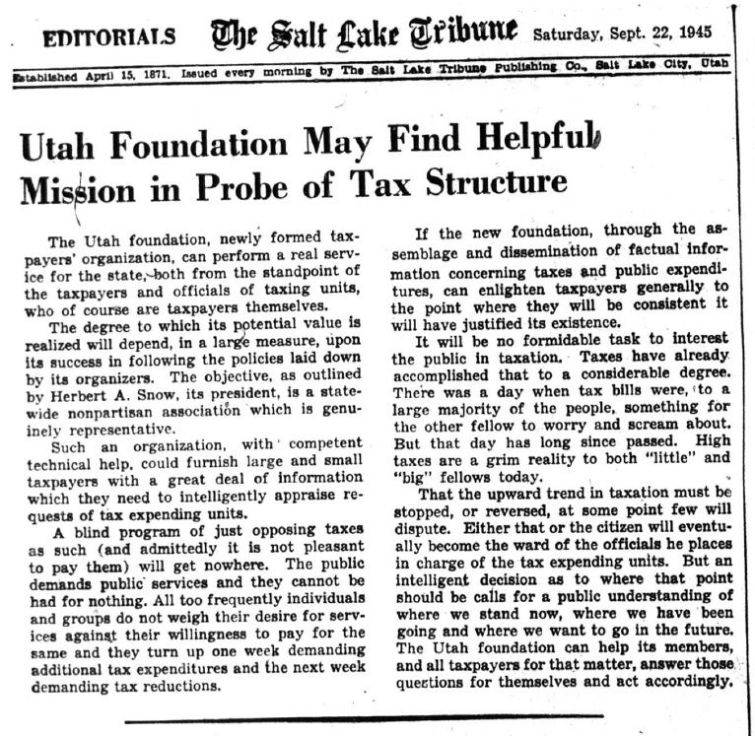
Fred S. Mulock, President
Salt Lake Chamber of Commerce
Photo credit: University of Utah Marriott Library Special Collections
Notes:
That memo was addressed to Fred S. Mulock, who was leading the effort to organize an independent research group, having just concluded his service as president of the Salt Lake Chamber of Commerce. Fred Mulock was an executive of the United States Smelting, Refining and Mining Corporation, whose facilities and smokestacks occupied the land where Intermountain Medical Center is now located. From his downtown office on the 9th floor of the Newhouse Building, he worked to bring together more than fifty leaders of the business community at the Hotel Utah. They adopted the charter and appointed board members for what they called the Utah Foundation. The group included some names that are well-known even today: George S. Eccles, Harold B. Lee, J. Eastman Hatch and Herbert A. Snow, who served as the Foundation’s first president.
The reaction from Salt Lake City’s three daily newspapers was uniformly positive. The Salt Lake Telegram called it “an excellent move.” The Deseret News said the entire state “should welcome the formation of . . . a non-political, non-partisan fact-finding institution.” And the Salt Lake Tribune, a day after reporting on its formation, said the “Utah Foundation . . . can perform a real service for the state.”
Here we might pause to say that good relationships with media were important to Utah Foundation’s mission from the beginning, and 2015 will be a record year for coverage of our research reports. We’ve had more than 120 stories in newspapers, radio and television citing Utah Foundation research along with dozens of interviews and appearances by our president and our researchers.

Slide 4
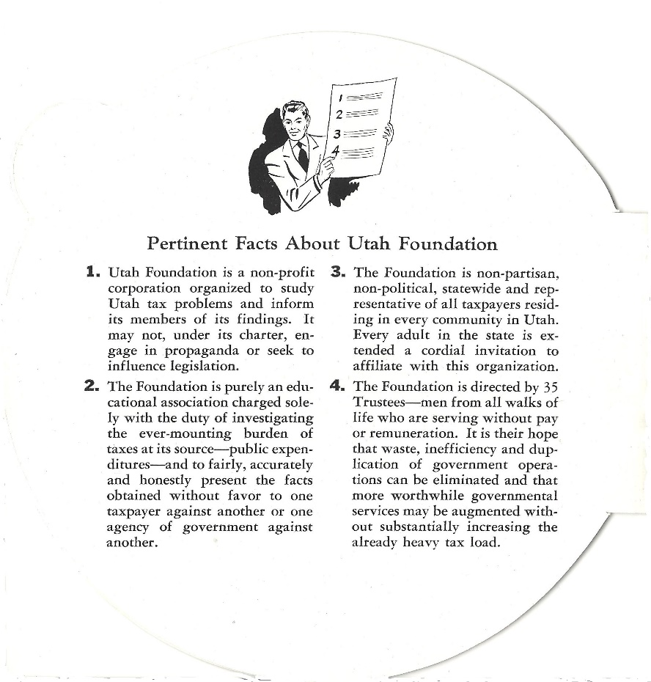
Notes:
Early in 1946, the leaders of the Utah Foundation felt a need to explain what they were doing to business and community leaders who were not involved in its initial organization. So they created this novelty pamphlet and mailed about three thousand of them all over the state. It was a high-energy presentation – this was the era before Downwinders and Mutually Assured Destruction. The mission of Utah Foundation, it explained, was to “fairly, accurately and honestly present the facts . . . without favor to one taxpayer against another or one agency of government against another.”

Slide 5
“Utah Foundation does no crusading or lobbying, it does not engage in propaganda, and it has supported no legislation nor has it opposed any. Its program: A tenacious aggressiveness in ferreting out and presenting facts.”
Christian Science Monitor
May 19, 1950
Notes:
Five years later, the Christian Science Monitor took a look at Utah Foundation under the leadership of Executive Director Henry Pearson and found it was doing just what its founders had in mind – impressed by its level of “tenacious aggressiveness.”

Slide 6
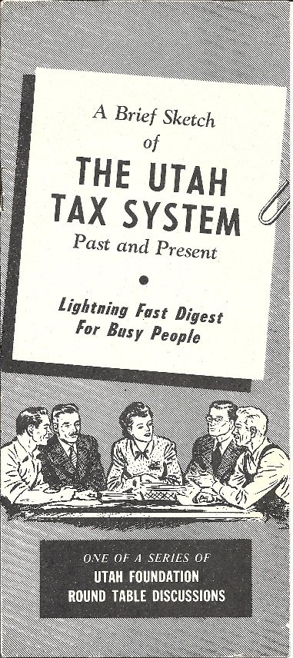
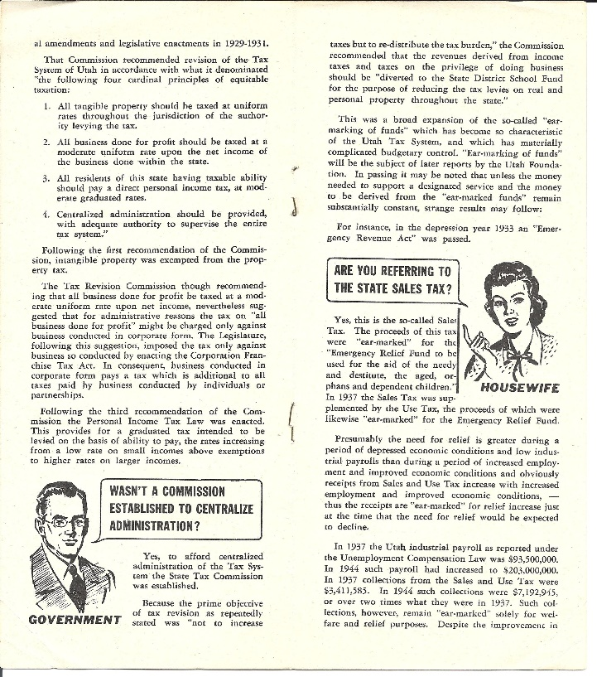
Utah Foundation – Research Report #1
Notes:
The very first Utah Foundation research report came out late in 1946, and it holds up remarkably well. It explains the reorganization of Utah’s state tax system in the 1920’s under Governor George Dern – a restructuring that is still the basis of Utah’s system. As it says, it was a “lightning-fast digest for busy people.”

Slide 7
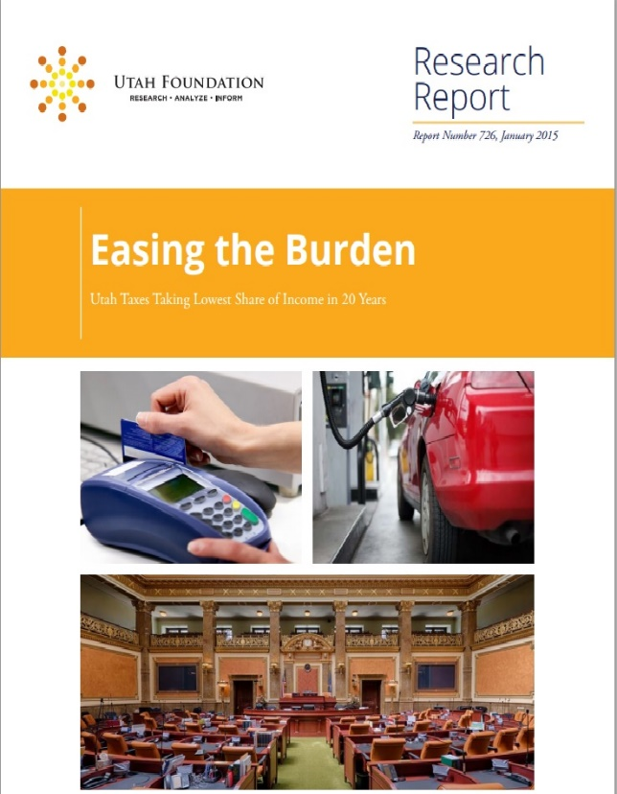
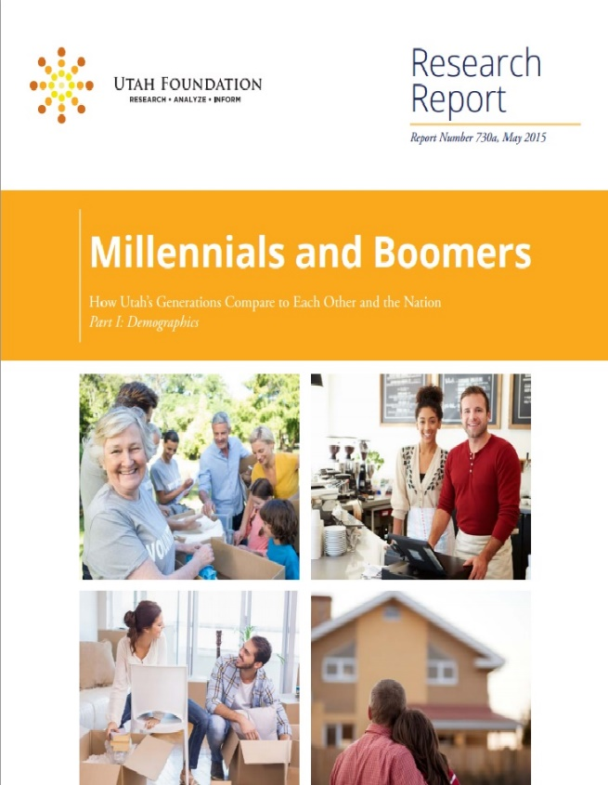
Utah Foundation – 2015 Research Reports
Notes:
Since then, Utah Foundation has published more than 700 research reports on a wide range of topics. Once every 30 years, it seems, we’re writing something about driving safety. In recent years, we’ve published extensively on Utah’s public schools, air quality, population growth, quality of life, and, of course, on the state’s tax system. Our first report for the year pointed out that Utah’s tax burden is the lowest it’s been in 20 years. Our recent series comparing Utah’s generations, Millennials and Baby Boomers, got extensive coverage in the Utah media.

Slide 8
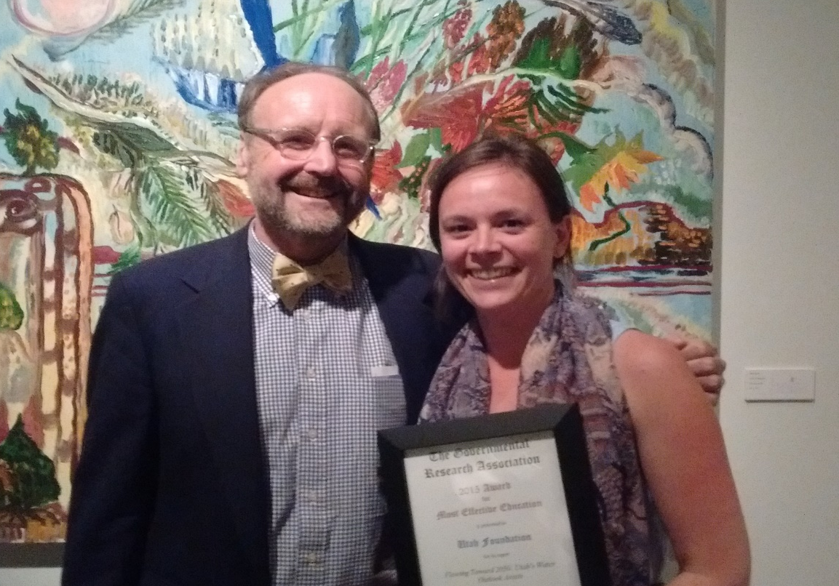
Utah Foundation Research Wins National Award
Notes:
The Utah Foundation report “Flowing Toward 2050: Utah’s Water Outlook” won the Most Effective Education Award from the Governmental Research Association at its recent meeting in Denver. This report has also received extensive media coverage and was the basis for a presentation by our president, Steve Kroes to a legislative interim committee. It’s the latest in a series of awards Utah Foundation has won over the years for its public policy research.

Slide 9
The mission of Utah Foundation is to promote:
A thriving economy,
A well-prepared workforce
And a high quality of life for Utahns
Notes:
Utah Foundation’s mission statement has evolved through the years, but it’s still true to the original intent of its founders: unbiased, non-partisan research meant to give the public and policymakers factual information they can trust. We appreciate your ongoing commitment to keep Utah Foundation independent and strong.

